Slide 1
DATA SCIENCE 101

Slide 2

Hello world!
I AM DANI WINTER
I am a data solutions engineer and I love to solve data problems and use fun maths!
You can find me at:
Danielle.winter@entelect.co.za

Slide 3
Agenda
Intro and Definitions
Data Science Workflow
Loading Data
Cleaning and Processing Data
Modeling Data
Evaluating Models
Visualising Results
Practical
Discussion
Resources
Summary

Slide 4
WHAT IS DATA SCIENCE?
Notes:
Ask the audience

Slide 5
Data Science is the use of scientific methods to extract knowledge and insights from data, enabling people to make smarter decisions.

Slide 6
A Data Scientist is a professional who uses scientific methods to create meaning from raw data
Notes:
- somebody who can play with data, spot trends and learn truths. Data scientists are inquisitive: exploring, asking questions, doing “what if” analysis, questioning existing assumptions and processes.

Slide 7

Data-Information- Knowledge-Wisdom PYRAMID
Mt Everest Example
Value Added
Data
Raw
Observation:
Discrete, objective, facts, figures, etc.
The height of Mt Everest, the days taken to climb it, the weather patterns, etc.
Information
Meaning
Interpretation:
Contextualised, categorised, calculated, condensed
Book on Mt Everest that describes the mountain and explains the best methods to climb it
Knowledge
Context
Connections:
Comparisons, consequences, conversations
Understanding based on experience climbing mountains, advising people on the way to reach Mt Everest's peak
Wisdom
Applied
Actionable Intelligence:
Establish and reach measurable goals; wiser decisions
Climbing Mt Everest
Notes:
What do we mean by creating meaning from data?
The goal is to get actionable insights from raw data – the wisdom to make changes to make systems better or to take action

Slide 8

WHAT ELSE IS OUT THERE?
Data Engineer
Database Administrator
Machine Learning engineer
Data Analyst
Analytics Engineer
Notes:
Have you heard of other names or roles in data?
Data science is not a role which is clearly defined and set in stone – data scientists cannot just do data analysis in isolation. They have many jobs and many names and if you work in data, you’ll find yourself taking on all sorts of roles.

Slide 9
Let’s just focus on what a “data scientist” does today

Slide 10
Agenda
Intro and Definitions
Data Science Workflow
Loading Data
Cleaning and Processing Data
Modeling Data
Evaluating Models
Visualising Results
Practical
Discussion
Resources
Summary

Slide 11
TYPICAL DATA SCIENCE WORKFLOW
Loading data
Cleaning and preprocessing
Data Modelling
Evaluating Models
Visualising and sharing knowledge

Slide 12
Agenda
Intro and Definitions
Data Science Workflow
Loading Data
Cleaning and Processing Data
Modeling Data
Evaluating Models
Visualising Results
Practical
Discussion
Resources
Summary

Slide 13
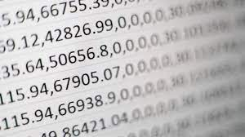
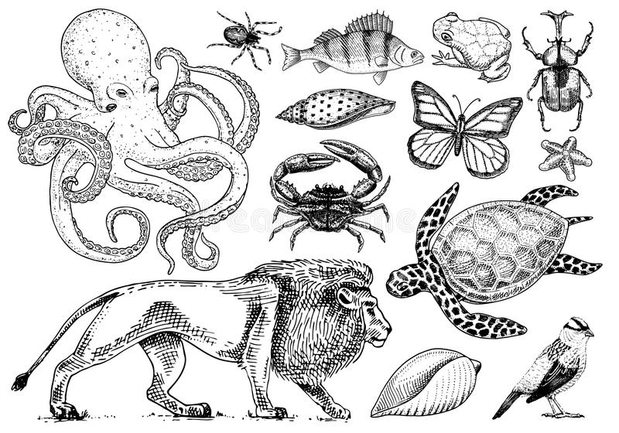
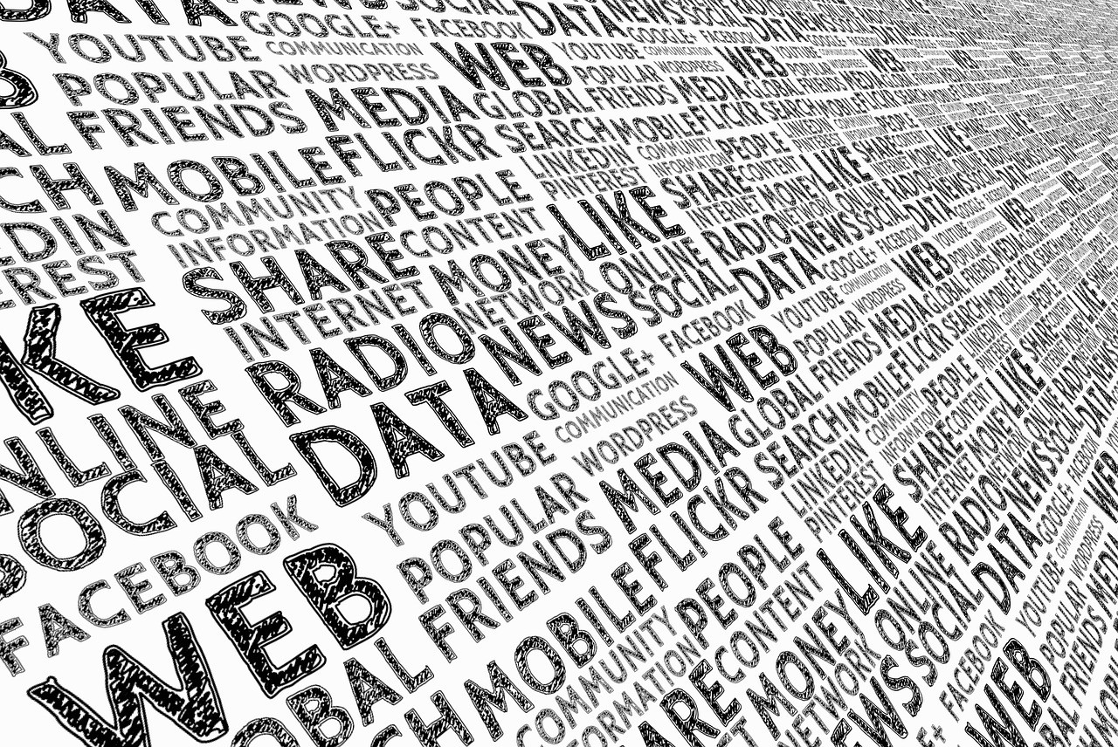
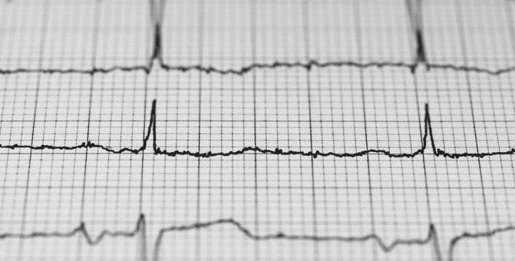
DATA LOADING – Types of data
Notes:
numerical data,
categorical data,
time series data, and
text data

Slide 14






DATA LOADING – How is data stored?
Databases
Cloud storage
Flat files
ETL
Extract
Transform
load
Application logs
Network traffic logs
Webservices & APIs
Notes:
Data comes form loads of different sources and can take on many forms
Excel spreadsheet
Text files
Image files
Streaming data
Log files when an application runs
Can be stored in different places – on your PC, in a database (local), in a DB in the cloud
We use a process called ETL to get our data in the right place and in the right format to start cleaning and processing
Extract the raw data, transform it into a suitable format, load it into a place where it is accessible for analytics

Slide 15
Agenda
Intro and Definitions
Data Science Workflow
Loading Data
Cleaning and Processing Data
Modeling Data
Evaluating Models
Visualising Results
Practical
Discussion
Resources
Summary

Slide 16
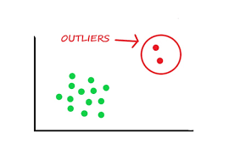

CLEANING AND PREPROCESSING
Missing values
Outliers
Notes:
Data prep is 80% of your job as a DS!
Missing data – blanks,
Nans in code
Nulls
Outliers don’t fit the usual trend – might be a mistake in recording the data
Skews the dataset
Not an accurate representation of the norm

Slide 17
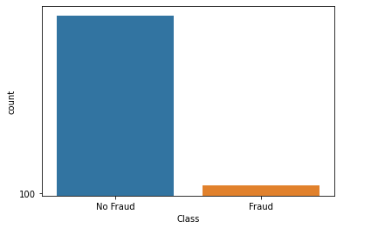
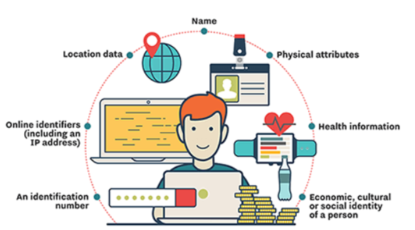
CLEANING AND PREPROCESSING
Imbalanced data
Sensitive data
Notes:
Imbalance – bias in the dataset
Predict one thing more than another
What are examples of sensitive data?
Medical
ID number
Credit card/ banking details
Location
Personally identifiable info

Slide 18
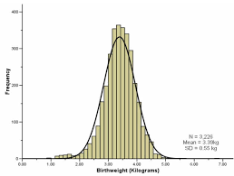
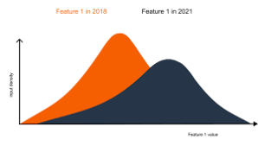
CLEANING AND PREPROCESSING
Data drift
Normality
Notes:
Drift – input data changes over time so model gets less accurate
Normality – an assumption we make. But not all datasets follow a normal distribution
We need to be aware of this because some models assume this

Slide 19
Agenda
Intro and Definitions
Data Science Workflow
Loading Data
Cleaning and Processing Data
Modeling Data
Evaluating Models
Visualising Results
Practical
Discussion
Resources
Summary

Slide 20
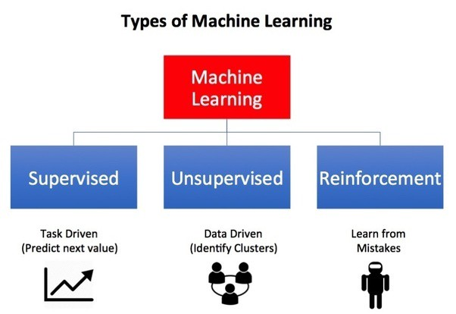
DATA MODELLING – Types of learning
Notes:
Machine learning is a sub-field of AI (train a machine to make decisions like a human would)
Machine learning models are mathematical or statistical formulas
Deep learning is a sub-field of machine learning – it uses neural network models with many layers

Slide 21
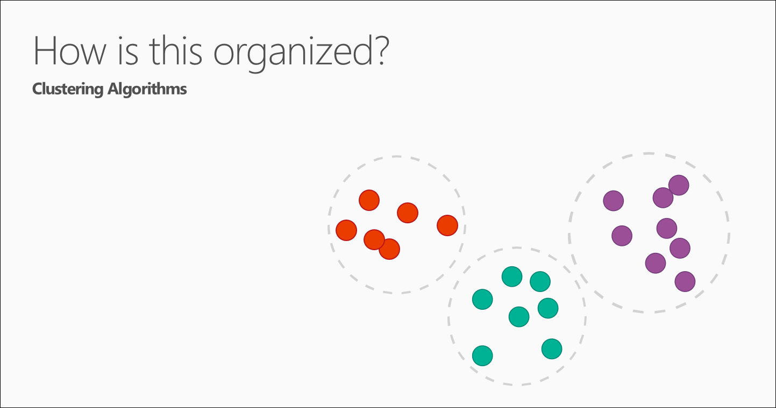
DATA MODELLING - Clustering
How is this data organized?
Which shoppers have similar tastes?
Which viewers like the same kind of movies?
Notes:
Normally unsupervised learning but can be supervised
We are trying to find trends in the data – can we find groups when we explore and plot the data?

Slide 22
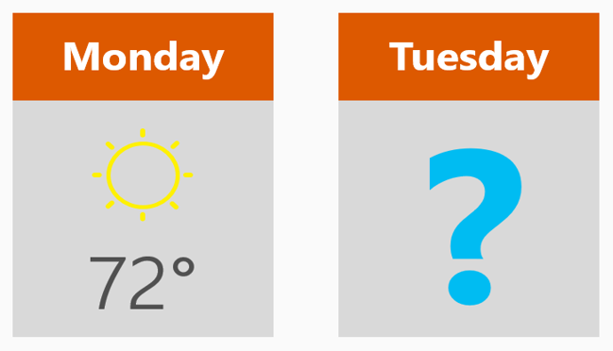
DATA MODELLING - Regression
How much or how many?
What will the temperature be next Tuesday?
What will my fourth quarter sales be?
Notes:
Data is numerical and we have the input and the output
We are trying to predict a future value that we don’t have and then measure how well we predicted it when we do get it’s real value
Normally predicting something continuous

Slide 23
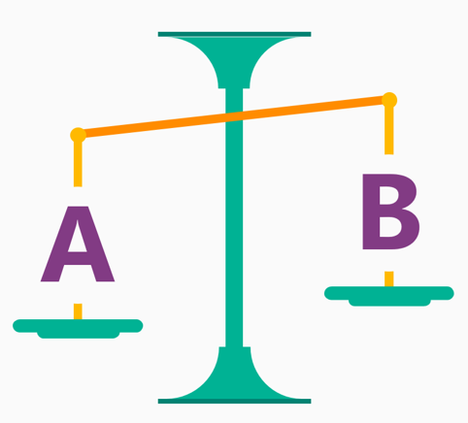
DATA MODELLING - Classification
Is this A or B?
Will this customer renew their subscription?
What species of flower is this?
Notes:
Data can be numerical, text, images etc
We are predicting something discrete – A or B

Slide 24

DATA MODELLING – Reinforcement Learning
What should I do now?
Should I continue driving at the same speed, brake, or accelerate in response to that yellow light?
Notes:
Different kind of learning gaining popularity
Agent interacting with an environment
Gets a reward based on the outcome of the interaction and rules that are in the environment
Best action gets the best reward
This is how people train game AIs that outperform people – they are optimized to select the best action

Slide 25
Agenda
Intro and Definitions
Data Science Workflow
Loading Data
Cleaning and Processing Data
Modeling Data
Evaluating Models
Visualising Results
Practical
Discussion
Resources
Summary

Slide 26
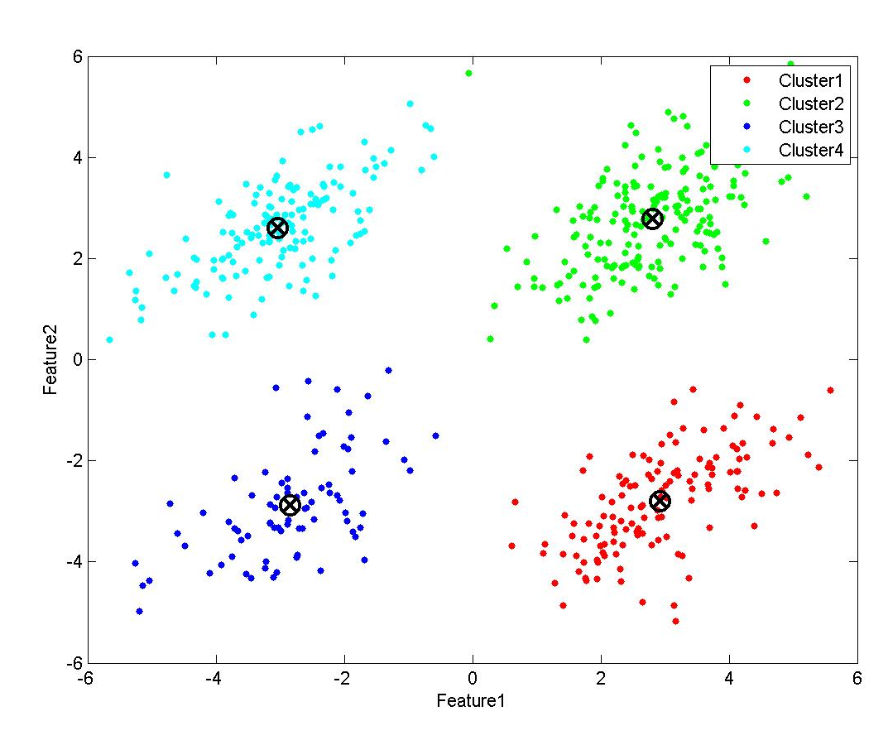
EVALUATING MODELS - Clustering
Notes:
Clustering – based on distances to centroids – the middle point of a cluster

Slide 27
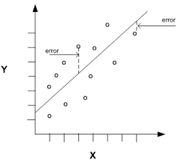
EVALUATING MODELS - Regression
Notes:
Regression – based on distances
Mean square error
Root mean square error
Mean absolute error

Slide 28
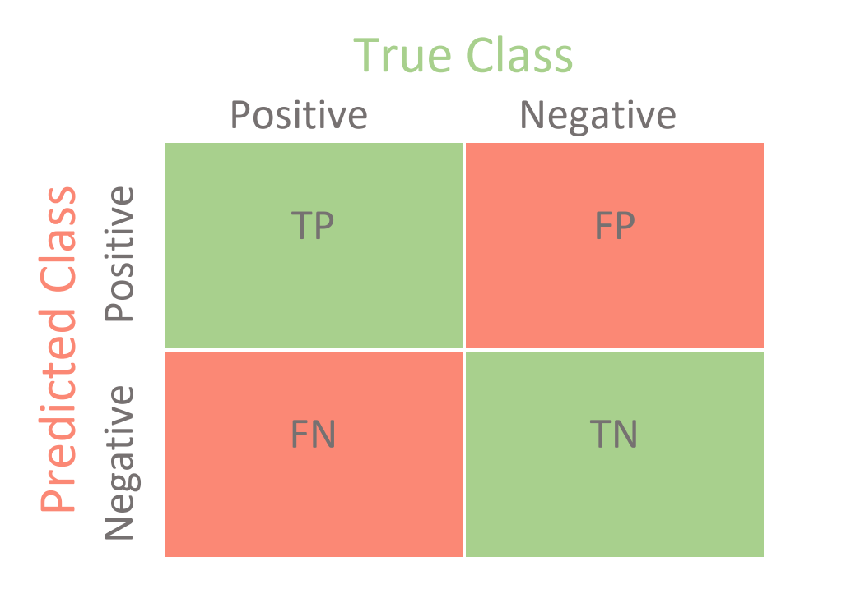
EVALUATING MODELS - Classification
Notes:
Classification – accuracy – how often are we correct
True positives and true negatives

Slide 29
Agenda
Intro and Definitions
Data Science Workflow
Loading Data
Cleaning and Processing Data
Modeling Data
Evaluating Models
Visualising Results
Practical
Discussion
Resources
Summary

Slide 30
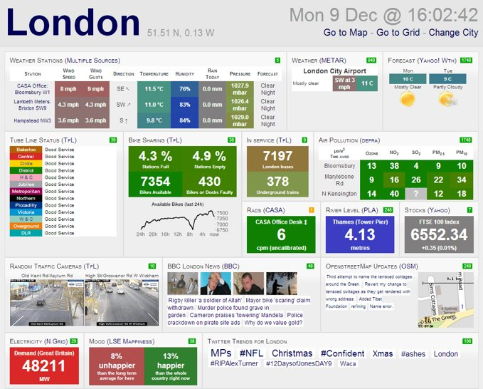
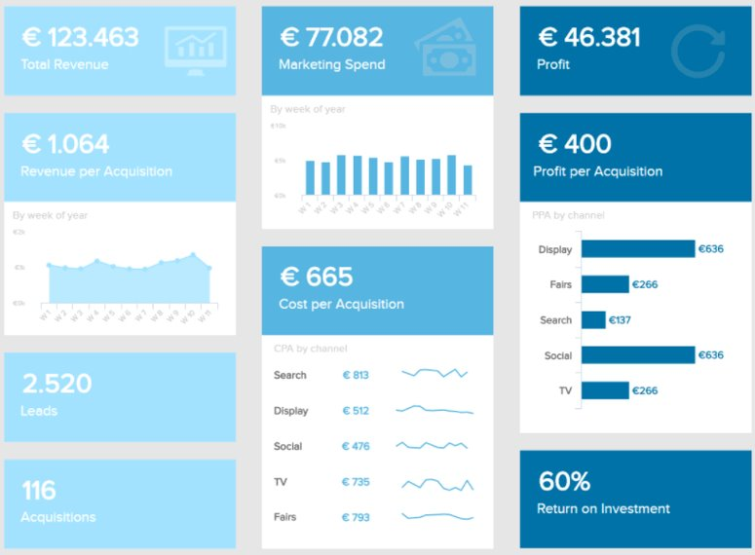
VISUALISING DATA
vs
Notes:
Which dashboard is clearer or easier to read?

Slide 31
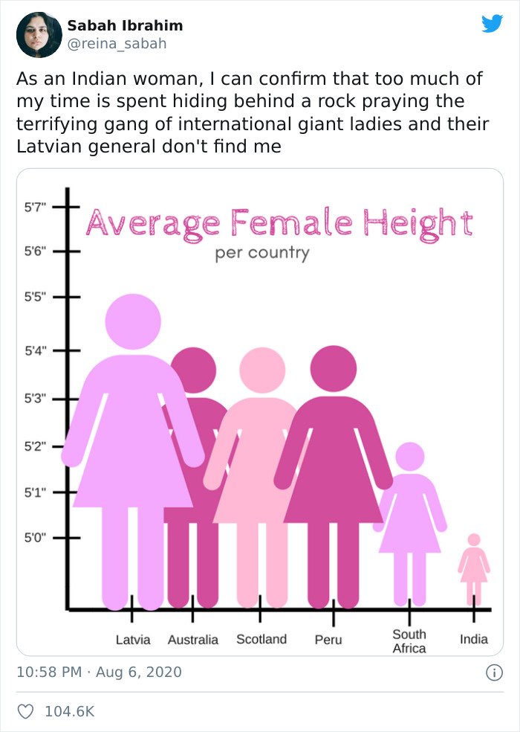
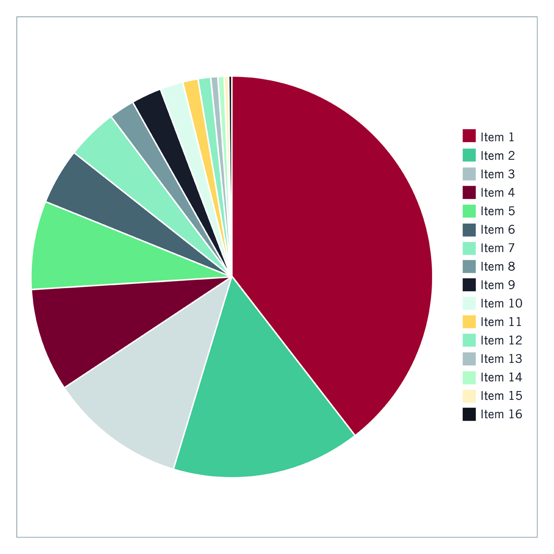
VISUALISING DATA

Slide 32
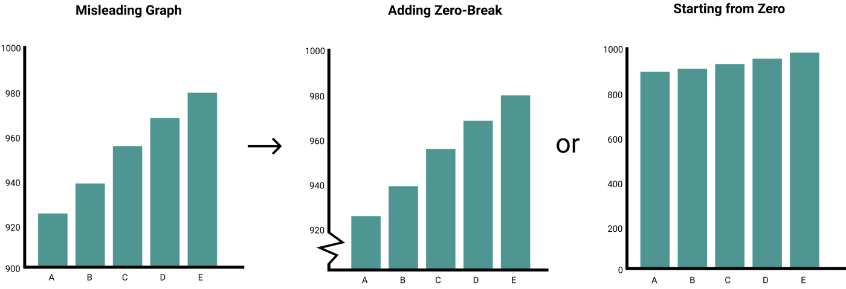
VISUALISING DATA
Notes:
Better ways to represent data

Slide 33
Agenda
Intro and Definitions
Data Science Workflow
Loading Data
Cleaning and Processing Data
Modeling Data
Evaluating Models
Visualising Results
Practical
Discussion
Resources
Summary

Slide 34
PRACTICAL Exploratory Data Analysis and Modeling

Slide 35
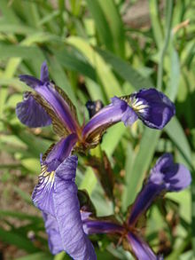
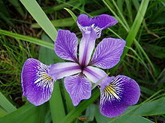
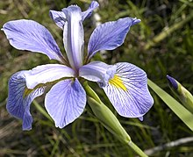
The Dataset
Iris versicolor
Iris virginica
Iris setosa

Slide 36
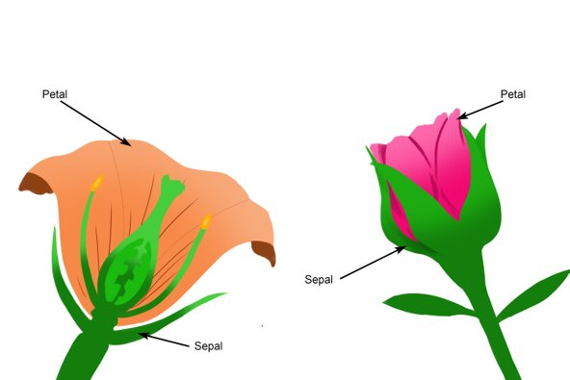
The Dataset

Slide 37
Practical set up
Go to binder in your browser
https://mybinder.org/
2. Paste in the name of the repository
https://github.com/DanielleWinter/ds101_iris_dataset.git

Slide 38
Agenda
Intro and Definitions
Data Science Workflow
Loading Data
Cleaning and Processing Data
Modeling Data
Evaluating Models
Visualising Results
Practical
Discussion
Resources
Summary

Slide 39
DISCUSS

Slide 40
Answers
Is this a supervised or an unsupervised data set if we want to predict the iris species? Supervised
If we want to build a model to find the iris species, what type of machine learning could we use? D
Is the iris dataset balanced? (y/n) Yes
How many data points are in the dataset? 150
What is the average petal length across all iris species? 3.758667
Is there any missing data in this dataset? No

Slide 41
Answers
Are there any outliers in the data? Yes
From the pairplot, which iris species is separated from the other two across all feature combinations? Iris setosa
Looking at this data, what type of machine learning model would you choose to create groups? Clustering or classification
For the test sample is the predicted species correct? No
From the graphs, are the predicted clusters the same as the ground truth? No

Slide 42
Agenda
Intro and Definitions
Data Science Workflow
Loading Data
Cleaning and Processing Data
Modeling Data
Evaluating Models
Visualising Results
Practical
Discussion
Resources
Summary

Slide 43
RESOURCES

Slide 44
RESOURCES
Coursera: machine learning course with Andrew Ng
Udemy Data Science Bootcamp
Certifications with tools Azure, AWS, IBM
Useful sites:
https://towardsdatascience.com
https://www.discoverdatascience.org/articles/
Applicable qualifications:
Typically part of a BSc with maths, science or engineering

Slide 45
Agenda
Intro and Definitions
Data Science Workflow
Loading Data
Cleaning and Processing Data
Modeling Data
Evaluating Models
Visualising Results
Practical
Discussion
Resources
Summary

Slide 46
WHAT WE'VE LEARNT
Definition of data
Intro to what a Data Scientist does
Data Science Workflow
Loading data
Processing data
Modeling data
Evaluating models
Visualising results
Hello World example of DS!

Slide 47
Thanks!
ANY QUESTIONS?
You can find me at:
danielle.winter@entelect.co.za

